Slide 1
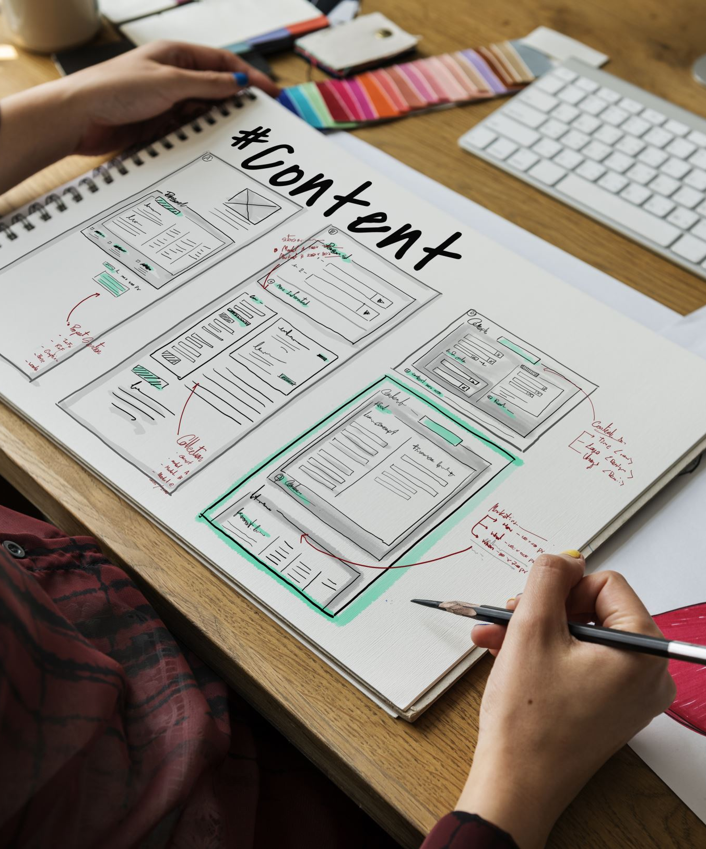
Web Application Development
Part: 01
An Introduction to MVC Core and Project Structure
Part: 02
MVC Core Framework Terminologies
By Ebad Majeed

Slide 2
Migrating to Visual Studio
If you are new to Dot NET technologies, its project structure could be very confusing, especially MVC Core template.
Let’s have a look at the MVC Core project structure and what it means.

Slide 3
Project Structure
Main Components (not all)
Dependencies
Properties
wwwroot
Controllers
Models
Views
appsettings.json
Program.cs
Startup.cs (2019 version template)

Slide 4
Dependencies
The Dependencies in the ASP.NET Core 2.0 onwards project contain all the installed server-side NuGet packages as well as client-side frameworks such as jQuery, AngularJS, Bootstrap etc. These client-side dependencies are managed using Bower in Visual Studio.
Bower is a package manager primarily for (but not limited to) front-end Web development
NuGet is also a package manager

Slide 5
Properties
The Properties node includes launchSettings.json file which includes Visual Studio profiles of debug settings.
We can change environment variables if we want to

Slide 6
wwwroot
From name we can clearly tell that it is the web root folder
Only those files that are in the web root - wwwroot folder can be served over an http request. All other files are blocked and cannot be served by default.
Usually contains folders like:
Css
Lib
Bootstrap and jQuery (Validations)
Js
images

Slide 7
MVC
The Model-View-Controller (MVC) is an architectural pattern that separates an application into three main logical components: the model, the view, and the controller. Each of these components are built to handle specific development aspects of an application. MVC is one of the most frequently used industry-standard web development framework to create scalable and extensible projects.
In MVC Core project structure we will see three different folders:
Models
Views
Controllers

Slide 8
Models
The Model component corresponds to all the data-related logic that the user works with. This can represent either the data that is being transferred between the View and Controller components or any other business logic-related data. For example, a Customer object will retrieve the customer information from the database, manipulate it and update it data back to the database or use it to render data.

Slide 9
Views
The View component is used for all the UI logic of the application. For example, the Customer view will include all the UI components such as text boxes, dropdowns, etc. that the final user interacts with.

Slide 10
Controllers
Controllers act as an interface between Model and View components to process all the business logic and incoming requests, manipulate data using the Model component and interact with the Views to render the final output. For example, the Customer controller will handle all the interactions and inputs from the Customer View and update the database using the Customer Model. The same controller will be used to view the Customer data.

Slide 11
Program.cs
ASP.NET MVC Core web application is actually a console project which starts executing from the entry point:
app.run();

Slide 12
Startup.cs (2019 version)
ASP.NET Core application must include Startup class. It is like Global.asax in the traditional .NET application. As the name suggests, it is executed first when the application starts.

Slide 13
Important concepts in Dot NET Development
Dependency Injections
Migrations
Scaffolding
Entity Framework
TAP
Task
Thread
Difference b/w Task and Thread
Anti-Forgery Token
Lambda Expressions
LINQ

Slide 14
Dependency Injections
Dependency injection is a technique whereby one object (or static method) supplies the dependencies of another object. A dependency is an object that can be used (a service). An injection is the passing of a dependency to a dependent object (a client) that would use it.
The service is made part of the client's state. Passing the service to the client, rather than allowing a client to build or find the service, is the fundamental requirement of the pattern.
The intent behind dependency injection is to decouple objects to the extent that no client code has to be changed simply because an object it depends on needs to be changed to a different one. This permits following the Open / Closed principle.

Slide 15
Migrations
The Migrations feature enables you to change the data model and deploy your changes to production by updating the database schema without having to drop and re-create the database.

Slide 16
Entity Framework
Entity Framework is an object-relational mapper (O/RM) that enables .NET developers to work with a database using .NET objects. It eliminates the need for most of the data-access code that developers usually need to write.

Slide 17
Scaffolding
MVC Core scaffolding provides a quick way to generate the CRUD operations in a standardized way, creating the necessary logic that lets your application interact with the database layer.
In later lessons, We will learn how to use ASP.NET MVC scaffolding with different approaches. We can also update our model applying the changes in the database by using Entity Framework Migrations.
Notes:
Support

Slide 18
TAP
Task-based Asynchronous Programming model. Also known as Task-based Asynchronous Pattern.
TAP != Threads(Parallel Programming) and TAP != Sequential Programming
Consider a breakfast example:
Boiling 2 eggs (5 minutes)
Pouring juice (5 Seconds),
Using toaster (2 minutes),
Applying jam (1 minute)

Slide 19
TAP (Cont’d)
Sequential Programming will execute all these four tasks in sequence (one after the other).
Thread will make sure that there are 4 cooks for these 4 breakfast tasks.
These concerns are important for the programs we write today. When we write client programs, we want the UI to be responsive to user input. Our application shouldn't make a phone appear frozen while it's downloading data from the web. When we write server programs, we don't want threads blocked. Those threads could be serving other requests. Using synchronous code when asynchronous alternatives exist, hurts your ability to scale out less expensively. we pay for those blocked threads.

Slide 20
TAP (Cont’d)
TPL (Task based library) is based on a concept of a task, which represents an asynchronous operation.
It provides two primary benefits:
More Efficient
More Scalable
Use of system resources
Notes:
Task Parallel Library

Slide 21
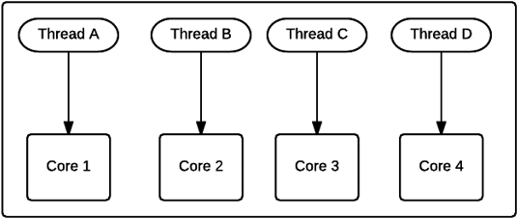
Thread
Dot NET Framework has thread-associated classes in System.Threading namespace. A Thread is a small set of executable instructions.

Slide 22
Why Threads?
There are times when the application is required to perform few tasks at the same time.

Slide 23
Task
Dot NET framework provides Threading.Tasks class to let you create tasks and run them asynchronously. A task is an object that represents some work that should be done. The task can tell you if the work is completed and if the operation returns a result, the task gives you the result.

Slide 24
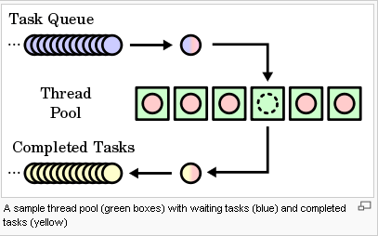
Task

Slide 25
Why Tasks?
It can be used whenever you want to execute something in parallel. Asynchronous implementation is easy in a task, using ’async’ and ‘await’ keywords.

Slide 26
Difference b/w Task and Thread
The Thread class is used for creating and manipulating a thread in Windows. A Task represents some asynchronous operation and is part of the Task Parallel Library, a set of APIs for running tasks asynchronously and in parallel.
The task can return a result. There is no direct mechanism to return the result from a thread.
Task supports cancellation through the use of cancellation tokens. But Thread doesn't.
A task can have multiple processes happening at the same time. Threads can only have one task running at a time.
We can easily implement Asynchronous using ’async’ and ‘await’ keywords.
A new Thread()is not dealing with Thread pool, whereas Task does use thread pool.
A Task is a higher level concept than Thread.

Slide 27
CSRF
Cross-Site Request Forgery (CSRF) is an attack where a malicious site (Hacker) sends a request to a vulnerable site where the user is currently logged in.
Anti-Forgery Token helps us to protect our app from these attacks.
An example

Slide 28
An Example of a CSRF Attack
A user logs into www.lloyds.com using forms authentication.
The server authenticates the user. The response from the server includes an authentication cookie.
Without logging out, the user visits a malicious web site. This malicious site contains the following HTML form:
<h1>You Are a Winner!</h1>
<form action="http://lloyds.com/api/account" method="post">
<input type="hidden" name="Transaction" value="withdraw" />
<input type="hidden" name="Amount" value="1000000" />
<input type="hidden" name=“Receiver" value=“hacker’s bank account details" />
<input type="submit" value="Click Me to get your prize"/> </form>
Notes:
Notice that the form action posts to the vulnerable site, not to the malicious site. This is the "cross-site" part of CSRF.

Slide 29
An Example of a CSRF Attack
The user clicks the submit button. The browser includes the authentication cookie with the request.
The request runs on the server with the user's authentication context, and can do anything that an authenticated user is allowed to do.
Although this example requires the user to click the form button, the malicious page could just as easily run a script that submits the form automatically. Moreover, using SSL (Secure Socket Layer) does not prevent a CSRF attack, because the malicious site can send an "https://" request.
Typically, CSRF attacks are possible against web sites that use cookies for authentication, because browsers send all relevant cookies to the destination web site. However, CSRF attacks are not limited to exploiting cookies.

Slide 30
Anti-Forgery Token
To help prevent CSRF attacks, MVC Core uses anti-forgery tokens, also called request verification tokens.
The client requests an HTML page that contains a form.
The server includes two tokens in the response. One token is sent as a cookie. The other is placed in a hidden form field. The tokens are generated randomly so that an adversary cannot guess the values.
When the client submits the form, it must send both tokens back to the server. The client sends the cookie token as a cookie, and it sends the form token inside the form data. (A browser client automatically does this when the user submits the form.)
If a request does not include both tokens, the server disallows the request.

Slide 31
Lambda Expressions
A lambda expression is a convenient way of defining an anonymous (unnamed) function that can be passed around as a variable or as a parameter to a method call. Many LINQ methods take a function (called a delegate) as a parameter. Here is an example of what a lambda expression looks like:
Func<int, int> multiplyByFive = num => num * 5;
// Returns 35
int result = multiplyByFive(7);
Notes:
Delegate is a function pointer,
The expression num => num * 5 is a lambda expression. The => operator is called the "lambda operator". In this example, num is an input parameter to the anonymous function, and the return value of this function is num * 5. So when multiplyByFive is called with a parameter of 7, the result is 7 * 5, or 35.

Slide 32
LINQ
LINQ (Language Integrated Query) is uniform query syntax in C# and VB.NET to retrieve data from different sources and formats. It is integrated in C# or VB, thereby eliminating the mismatch between programming languages and databases, as well as providing a single querying interface for different types of data sources.
For example, SQL is a Structured Query Language used to save and retrieve data from a database. In the same way, LINQ is a structured query syntax built in C# and VB.NET to retrieve data from different types of data sources such as collections, ADO.Net DataSet, XML Docs, web service and MS SQL Server and other databases.

Slide 33
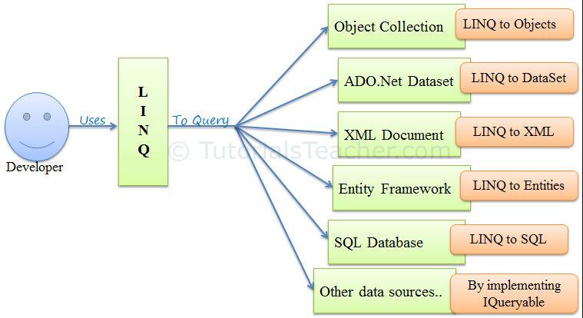
LINQ

Slide 34
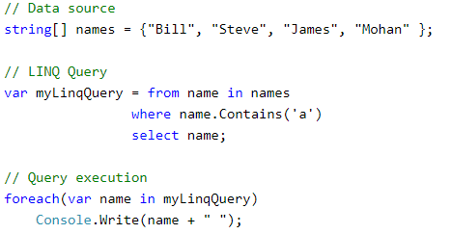
LINQ
LINQ queries return results as objects. It enables you to uses object-oriented approach on the result set and not to worry about transforming different formats of results into objects.

